Slide 1
What is github?

Slide 2
The wise Kodjo says..
“It’s like “track changes” in Word”

Slide 3
Why do I want to use it?
Paying someone to write code = paying someone to write a novel.
Great for collaboration
Great way to go back and fix stuff
Great way to see productivity
Lots of other features we won’t talk about today

Slide 4
Seems scary
It’s not, because this slide says so.
Built into OSX (mac) and linux by default
All servers have it
All developers should already use it
It’s no different than anything else
Command line never killed anyone

Slide 5
Github, vs git lab, vs bit bucket
All the same thing, just different services.
Similar to “starbucks vs pete’s vs dunken donuts”
All work pretty much the same

Slide 6
Hands on, lets jump in
Go to www.github.com
For those using windows, Google “Github for desktop” and download it

Slide 7
Basic features/commands
Git init
Git add .
Git commit –am “comment goes here”
Git push
Git branch (OMG! What’s a bRANcH!)
Git checkout

Slide 8
Git init
This one is pretty straight forward, Git init = git initialize.
Or Git start
Or get, do something!

Slide 9
Git add
This tells git to add all the changes you just made. So if you added something to your code, word document or picture, this tells git to pay attention to that change.
Command line:
Git add . (this means “Git, add everything I just changed). The dot = everything.

Slide 10
Git commit
A commit is like a “save” point. It’s a point in time that git knows stuff changed.
You can go back to a commit. If you broke something, you can go back in time and see where/how you broke it.

Slide 11
Git push
A “push” is when you take a copy of what’s on your computer, and “push” it to github.com.
Why? So everyone else on your team can see what you did. Example:
Keith makes edits to hello.txt
Claire also makes her own edits to hello.txt
Ryan comes in, and adds his own stuff to hello.txt
Now what? Github knows when/where each person made changes and manages them so they work well

Slide 12
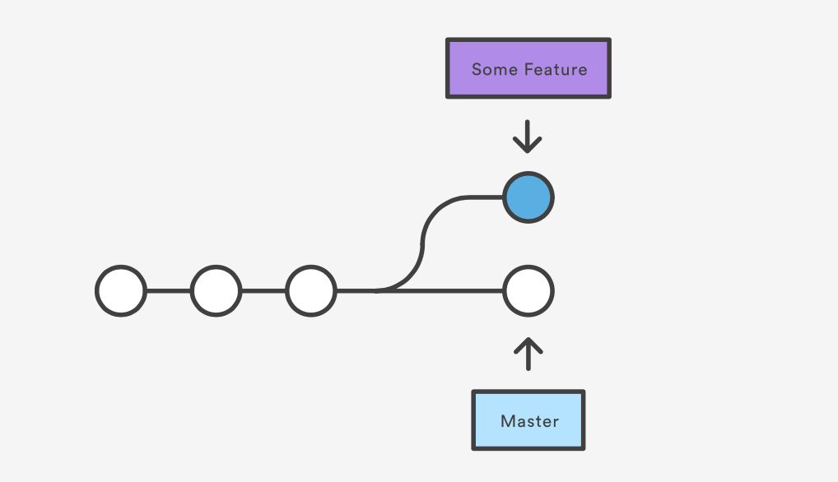
Git branch
Branches are similar to the previous concepts.
Why you branch?

